Slide 1
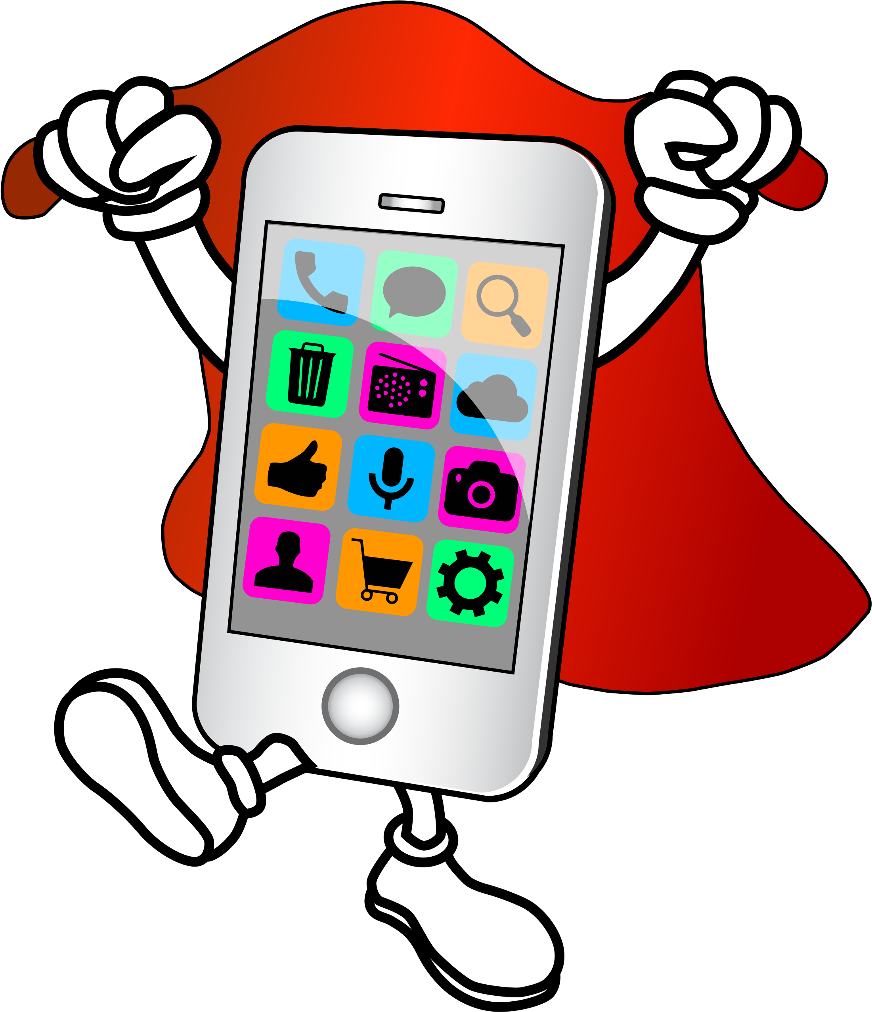
Mobile design tools

Slide 2
Mobile app designers are always looking for the right tool that will make their designs worthwhile for the end user. Developing a valuable mobile app requires top notch skill, creativity, and of course the right tools.

Slide 3

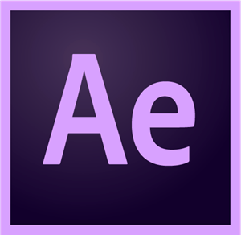

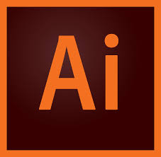
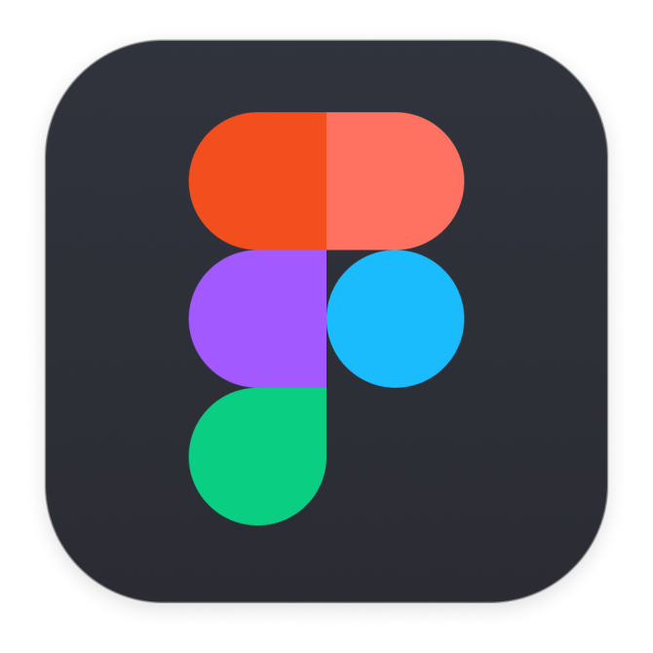
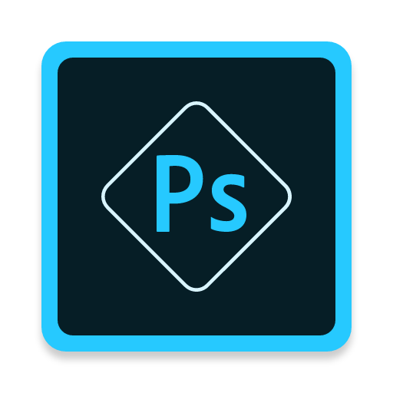
Some of the tools used by mobile designers

